Slide 1

Hashing Based Similarity Search over Massive Datasets
Jinfeng Li
Thesis Defense
Computer Science and Engineering
The Chinese University of Hong Kong
July 27, 2018
Notes:
Thanks for coming to my defense.
During my phd study, I initialize the project of large-scale similarity search
Today, I am going to present our contribution to this area. My thesis title is hashing based similarity search over massive dataset

Slide 2
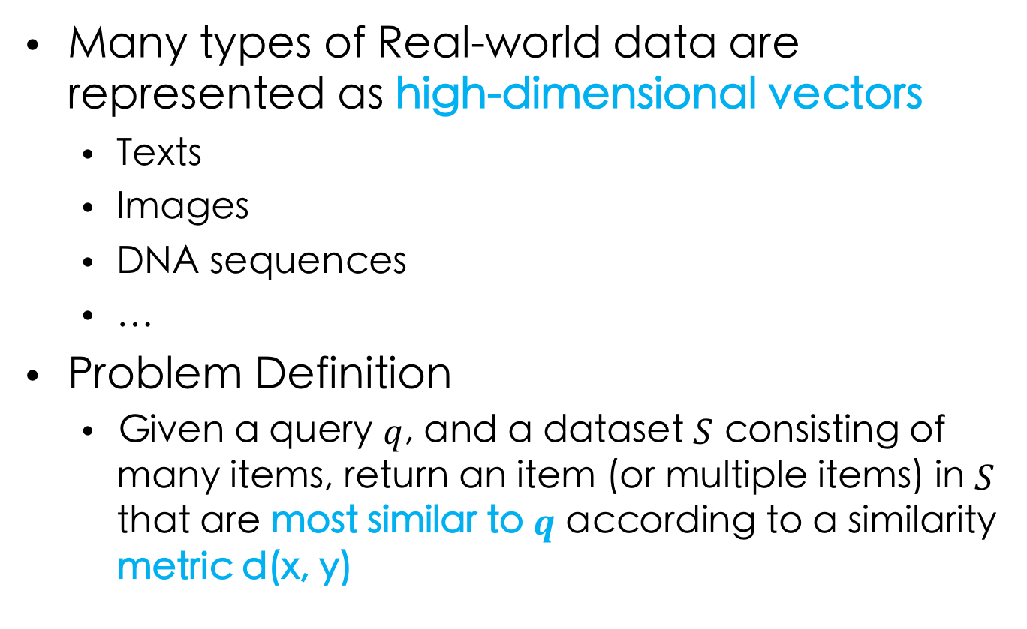
Similarity Search
Many types of Real-world data are represented as high-dimensional vectors
Texts
Images
DNA sequences
…
Problem Definition
Given a query $q$, and a dataset $S$ consisting of many items, return an item (or multiple items) in $S$ that are most similar to $q$ according to a similarity metric d(x, y)
Notes:
A bag of words
Collection of pixels
String of ATCG

Slide 3
Applications of Similarity Search
Recommendation
De-duplication
Entity resolution
Large-scale prediction
Neural network dropout
…
Notes:
User items
VeriGuid system

Slide 4
Synonyms in GLOVE word vectors
Word | Synonyms
amazing | awesome, wonderful, incredible, fantastic, perfect, fabulous, unreal
vocation | holiday, travel, summer, hawaii, honeymoon, getaway, vacay
communication | connection, understanding, relation, dialogue, technique, approach, structure
house | apartment, room, home, party, where, out, dad, sister
Notes:
Here shows an example of synonyms
Similarity search synonyms
Useful, Word replacement
Enlightening， communication understanding closely related to each other

Slide 5
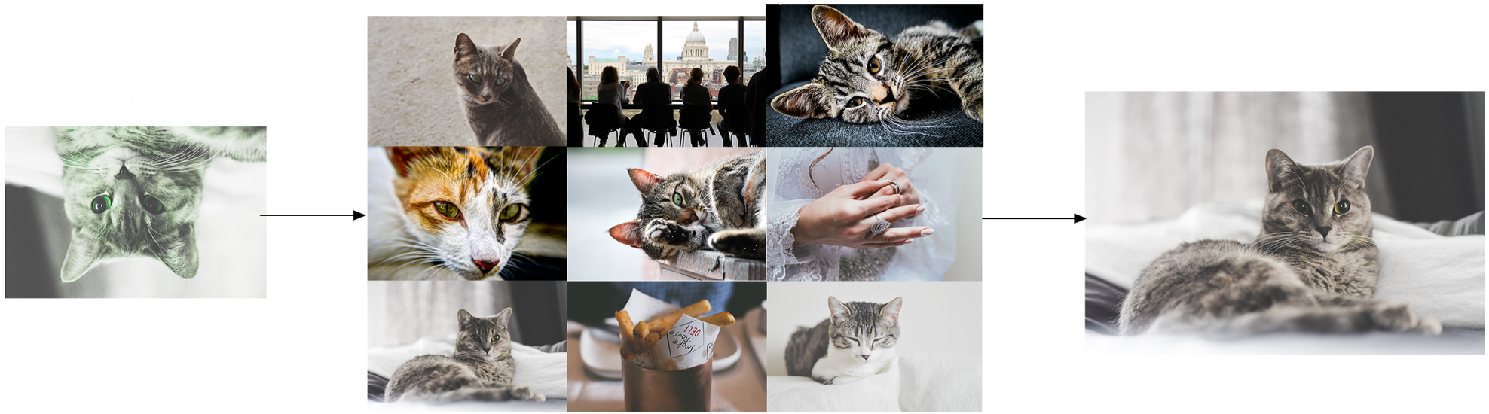
Image Retrieval
Query Image
Retrieved Image
Notes:
Similar similar images from a image stock
Computer vision: Taobao technique to retrieval billions of their item images. Tencent uses it to face recognition

Slide 6
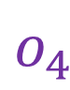
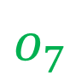
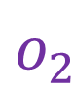
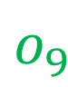

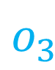
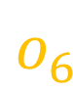

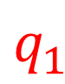
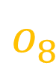
Hashing based similarity search
Linear scan evaluates all items
Hashing based similarity search tends to evaluate nearby items
Preprocessing
Partition items into buckets
by similarity
Querying
First evaluate items
in the nearest buckets
We normally use multiple hash tables
Notes:
Why hashing? For better efficiency
K-means
Closest center

Slide 7
Hashing based similarity search
Provide sublinear complexity
Guarantee the quality of retrieved results
Notes:
Probe nearest buckets first,
a small portion of the items
Return items close to the best answers (result not that bad)

Slide 8
The State of The Art
Numerous algorithms
Different distance metrics
Different partition methods
Challenges in massive datasets
Storage
Concurrent queries
Query efficiency
Notes:
Due to better efficiency,
Data of different distribution
However, these algorithms face a few challenges when processing large-scale dataset
Always need algorithms with better efficiency

Slide 9
Outline
LoSHa: A general distributed framework for locality sensitive hashing
Norm-ranging LSH: A Hashing schema for efficient maximum inner product search
GQR querying framework: A general and efficient querying framework for learning to hash algorithms
Notes:
This thesis makes contributions to these challenges. The first contribution I am going to show is LoSHa system.
LoSHa proposes to scale out existing algorithms to storage and process datasets in distributed manner
Norm-rangng LSH and GQR proposes new algorithms with better efficiency

Slide 10
Motivation
There are many LSH algorithms
Programming with existing distributed systems
High development cost
Unsatisfactory performance
Notes:
Different distance metrics and partition methods.
Design the DAG, Meanwhile, optimize the executions
Programming operators are not specifically optimized for LSH workloads
There are no dedicated programming interfaces for LSH workloads and users have to do the translation
Users have to optimize executions by themselves
Face challenges of storage and concurrent queries.
Existing solutions resort to open-source big data systems.
Adopt existing systems

Slide 11
Our solution: LoSHa
User-friendly high-level programming interface
Workload-specific system implementations and optimizations
Notes:
Reduces the development cost by designing a tailor-made, general
Achieves high performance by exploring

Slide 12
Preliminaries
Preprocessing
Partition items into buckets
by similarity
Querying
First evaluate items
in the nearest buckets
Multiple hash tables

Slide 13
LoSHa framework
Queries
Item
In pre-processing, item instances are created
Id of each item will be sent to associated buckets
Bucket
Item ids trigger the creation of bucket instances
Query
Query instances are created on receiving queries
q1
q2
q3
query
answer
Items
Buckets
i1
i2
i3
b1
b2
mapping
Notes:
Three abstractions
Functional call

Slide 14
Programming - Factory
calDist: return the distance of two vectors
calSigs: return bucket id of a given vector
Notes:
Used to handle hash functions
Distances to centers
Center of minimum distance
Use multiple hash tables to increase the probability of hashing query and its nearest neighbor to the same bucket

Slide 15
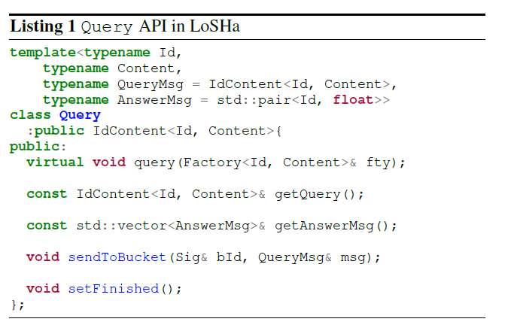
Programming - Query
Notes:
only several APIs, easily hardness
User only needs to implement the query function, invoke other APIs in the query function

Slide 16
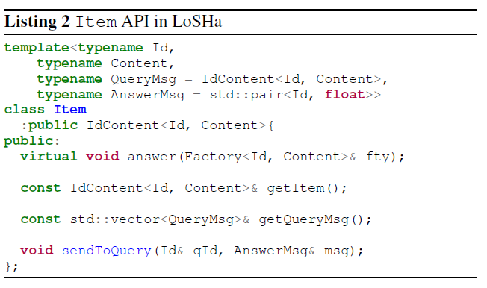
Programming - Item
Notes:
Only several APIs, use only need implement answer function

Slide 17
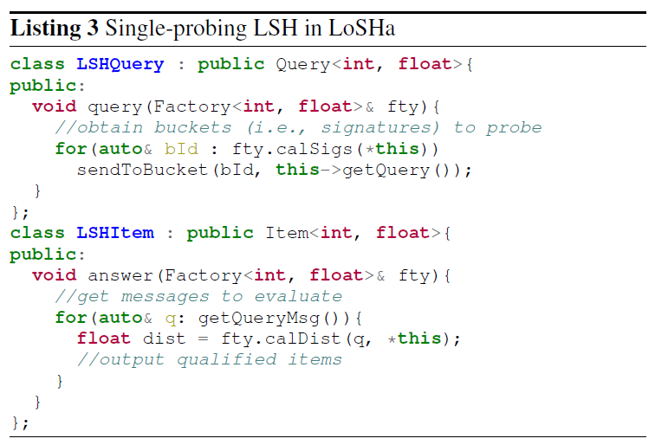
App: single-probing Algorithm
800 lines of code on Spark
1500 lines of code on Hadoop
100 lines of code on LoSHa
Notes:
Example of user code
This is an example of single-probing algorithm, which only probe the nearest bucket in multiple hash tables

Slide 18
Support of state-of-the-art algorithms
Conventional single-probing LSHs
One-bucket-per-table probing
Require tens or even hundreds of hash tables that exhaust the memory
Recent multi-probing LSHs (e.g. Multi-probe LSH, Hamming Ranking and C2LSH)
Multiple-buckets-per-table probing
Require less hash tables (e.g. about 10 times)
Notes:
As a tradeoff, the implementation becomes much more complicated, let us see how LoSHa reduces the development cost

Slide 19
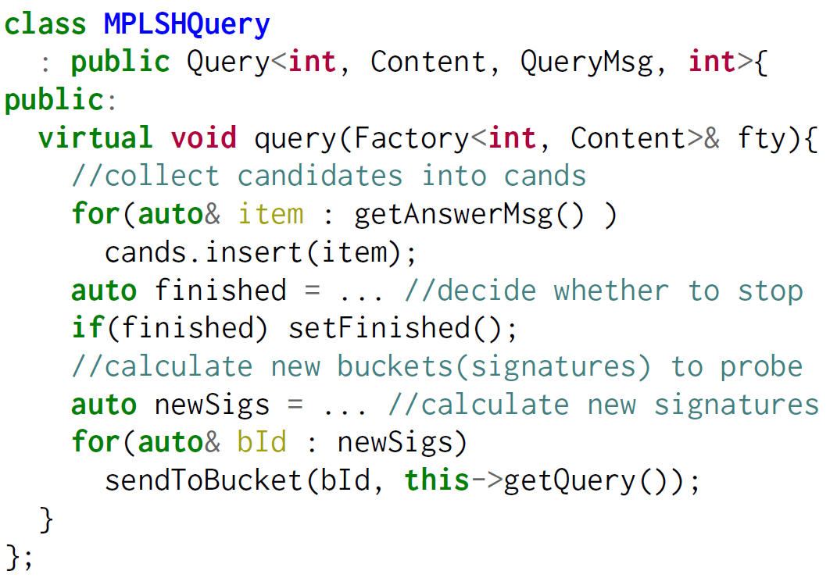
Programming – Multi-probing Algorithm

Slide 20
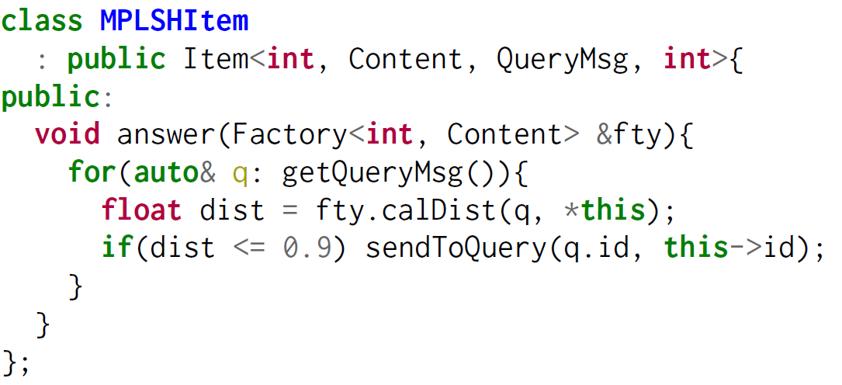
Programming – Multi-probing Algorithm

Slide 21
Optimizations
Message reduction
Query broadcast
Message combiner
De-duplication
Item-side de-duplication
Suitable for dense vector
Query-side de-duplication
Suitable for sparse vector
Notes:
When an item calculates the distance to a received query, the content of that query can be directly retrieved in local machine
Avoid attach query content in the query messages
Significant reduce the communication cost especially for multi-probing LSH
If query messages sent to multiple objects in the same worker are the same, only one query message will be sent
Effective when many hash tables are deployed

Slide 22
Optimizations
De-duplication
Item-side de-duplication
Avoid duplicate evaluations
Require more memory
Suitable for dense vector
Query-side de-duplication
Cannot avoid duplicate evaluations
Require less memory
Suitable for sparse vector
Notes:
For multi-probing LSH algorithms, an item may be revisited more than once by the same query, especially when L is large. LoSHa handles de-duplication flexibaly

Slide 23
Evaluation
Experimental settings
20 machines
1G network adapter
48G memory
Datasets
For each dataset, we sample 1000 items as queries
 | Item# | Dim# | Entry#
SIFT1B | 1,000,000,000 | 128 | 128
Tweets1B | 1,050,000,000 | 500,000 | Avg 7.5
Glove2.2M | 2,196,017 | 300 | 300
Notes:
Different characteristics

Slide 24
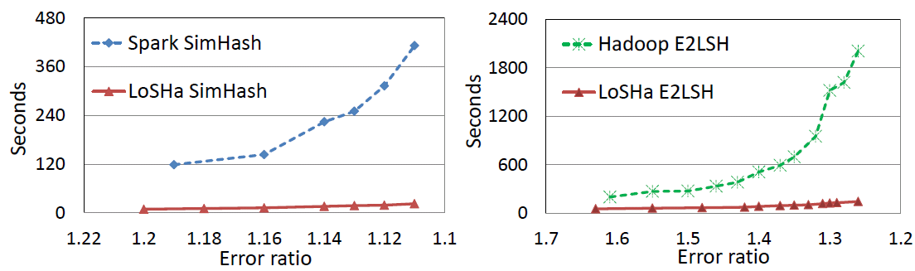
Comparison with LSH on Spark/Hadoop
Spark v.s QLSH
Hadoop v.s. QLSH
Smaller error ratio means higher quality of returned results
Notes:
We take open-source Spark/Hadoop implementations, without dedicated operators and optimizations

Slide 25
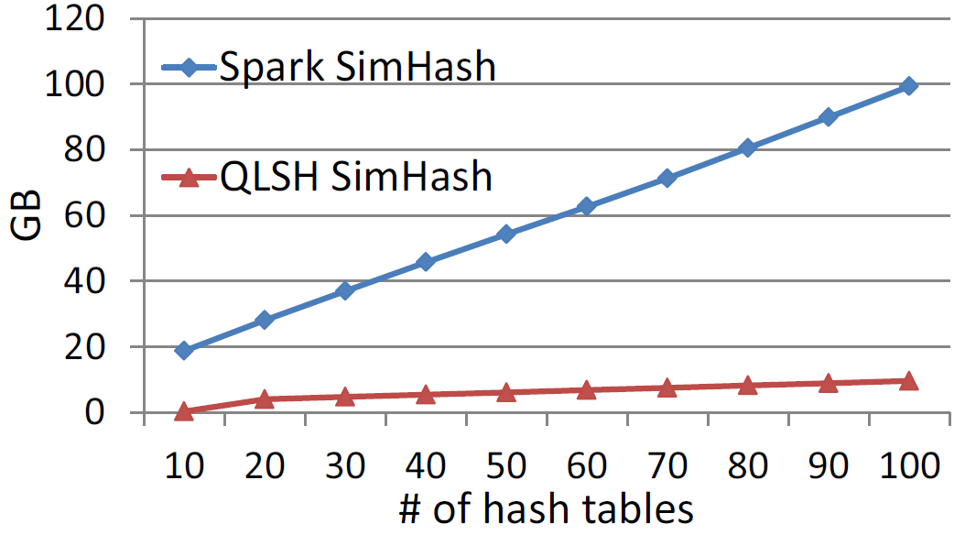
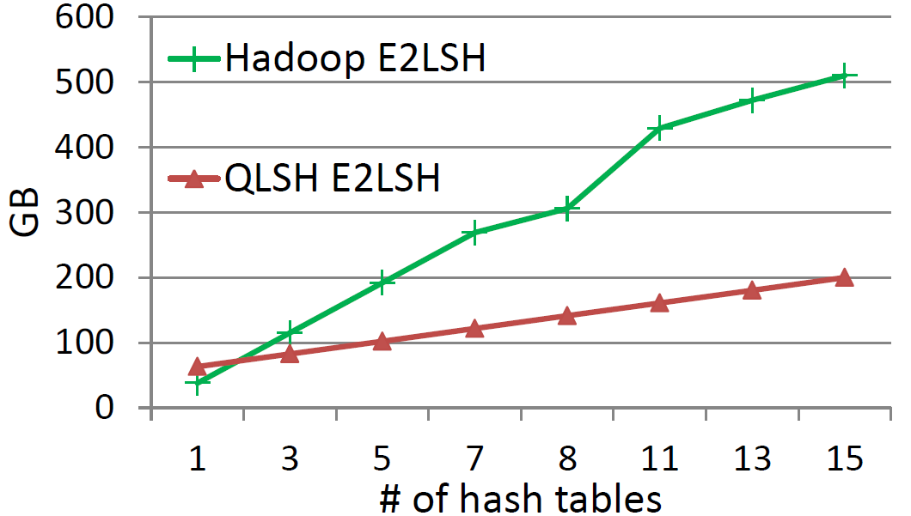
Network traffic
Spark v.s QLSH
Hadoop v.s. QLSH

Slide 26
Support of multi-probing LSH
PLSH
Fastest implementation of LSH (by Intel+MIT)
A single-probing LSH algorithm for Angular distance
Similarity search over 1 billion tweets of a high recall (i.e. 86%)
Deploy 780 hash tables
Require 100 machines with totally 6.4TB memory
Notes:
PLSH: sparse text data such as tweets
6.4 TB memory is a big budget of the company
Not applicable to small cluster of tens of machines

Slide 27
Support of multi-probing LSH
PLSH on LoSHa
Support maximum 55 hash tables due to memory insufficiency (0.96TB in our cluster, much less than 6.4TB required by PLSH)
Achieve a recall of 27.4% (far away from 86%)
Multi-probing PLSH on LoSHa
Probe multiple buckets inside each hash table
Improve the recall from 27.4% to 86.8%
Notes:
Our cluster is small

Slide 28
Support of multi-probing LSH
Average querying time
Development cost
About 200 lines of code
No need to handle distributed executions as PLSH does
Notes:
Although multiple-probing LSH can save memory, distributed implementation is much more complicated
200 lines of code

Slide 29
Outline
LoSHa: A general distributed framework for locality sensitive hashing
Norm-ranging LSH: A Hashing schema for efficient maximum inner product search
GQR querying framework: A general and efficient querying framework for learning to hash algorithms

Slide 30
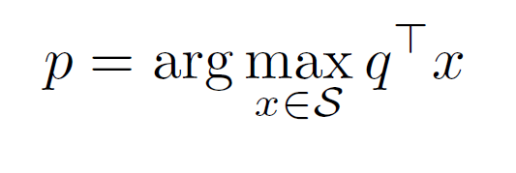
Maximum Inner Product Search
Maximum inner product search (MIPS) solves the following problem:
No existing hashing schema works for MIPS until 2014
ALSH (NIPS 2014, best paper)
Simple-LSH (ICML 2015, outperform ALSH)
Notes:
Applications: recommendation, large-scale prediction, neural network dropout

Slide 31
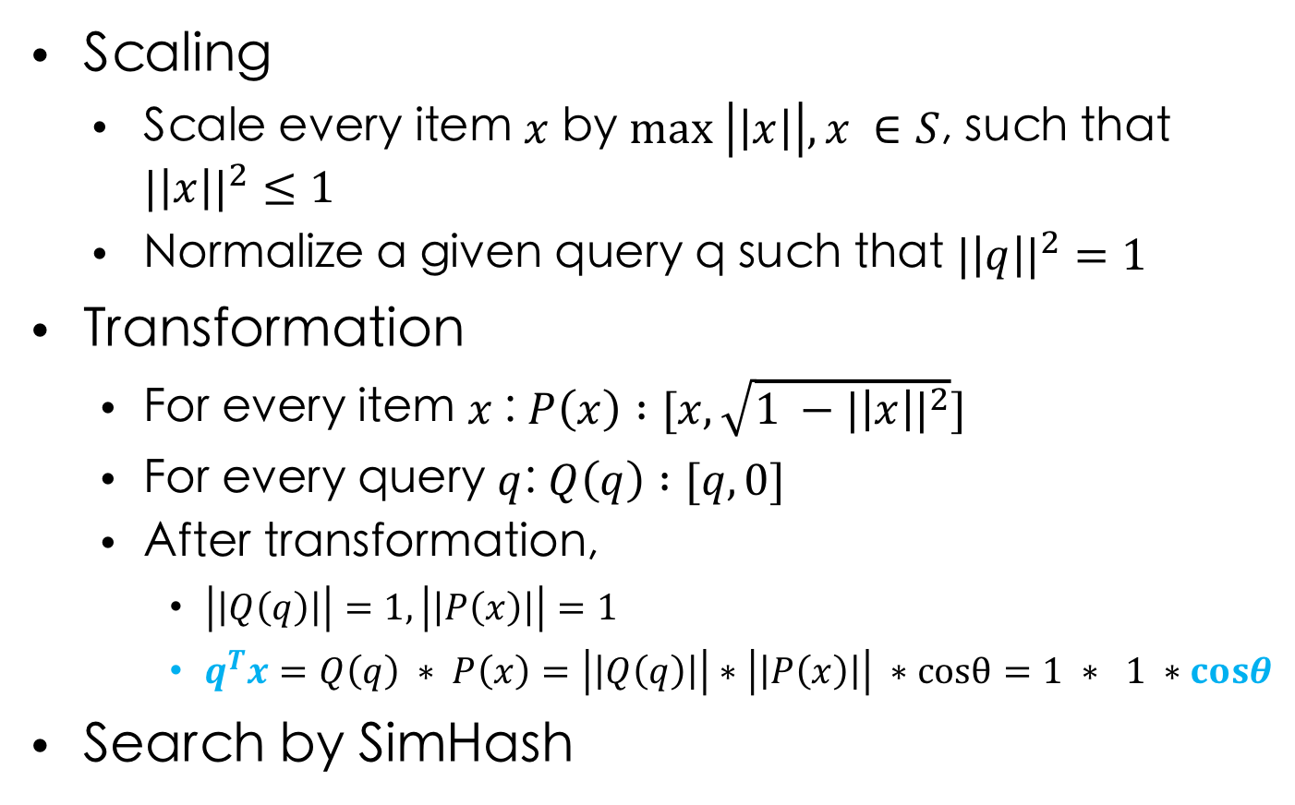
Simple LSH
Scaling
Scale every item $x$ by $max \left|\left|x\right|\right|, x ∈S$, such that ${|\left|x\right||}^{2}≤1$
Normalize a given query q such that ${|\left|q\right||}^{2}=1$
Transformation
For every item $x$: $P\left(x\right) :[x, \sqrt{1 −{|\left|x\right||}^{2}}]$
For every query $q$: $Q\left(q\right) :[q,0]$
After transformation,
$\left|\left|Q\left(q\right)\right|\right|=1, \left|\left|P\left(x\right)\right|\right|=1$
$q^{T}x=Q\left(q\right) ∗ P\left(x\right)=\left|\left|Q\left(q\right)\right|\right|∗\left|\left|P\left(x\right)\right|\right| ∗cosθ=1 ∗ 1 ∗cosθ$
Search by SimHash

Slide 32
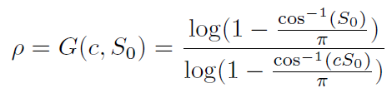
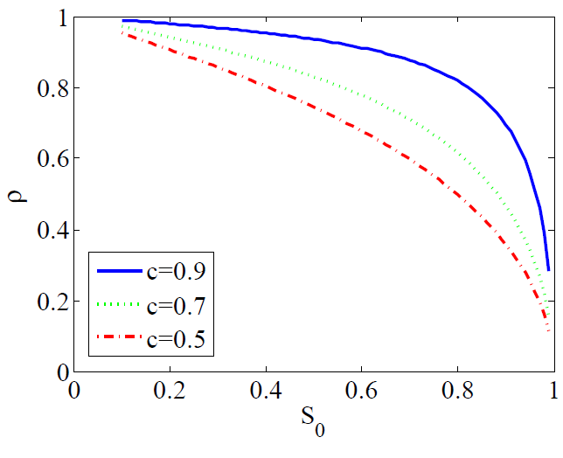
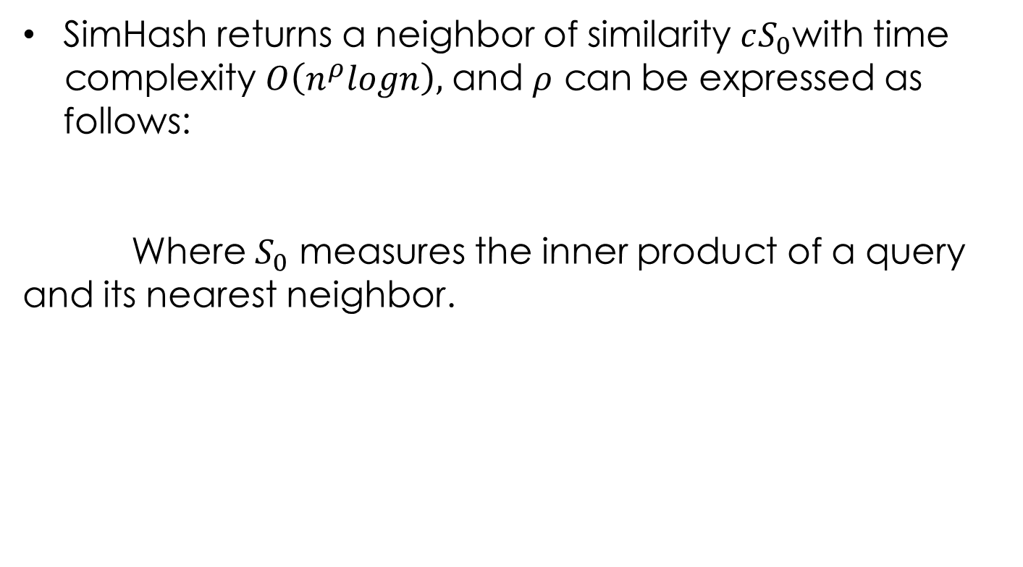
Performance of SimHash
SimHash returns a neighbor of similarity $cS_{0}$with time complexity $O\left(n^{ρ}logn\right),$ and $ρ$ can be expressed as follows:
Where $S_{0}$ measures the inner product of a query and its nearest neighbor.
Notes:
The higher is the similarity, the lower is the complexity
We want higher similarity

Slide 33
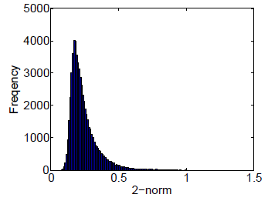
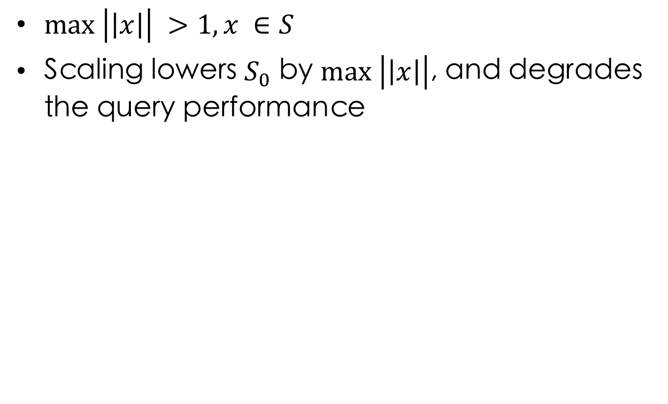
Problem of Simple LSH
$max \left|\left|x\right|\right| >1, x ∈S$
Scaling lowers $S_{0}$ by $max \left|\left|x\right|\right|$, and degrades the query performance
Notes:
The majority of the items will be affected

Slide 34
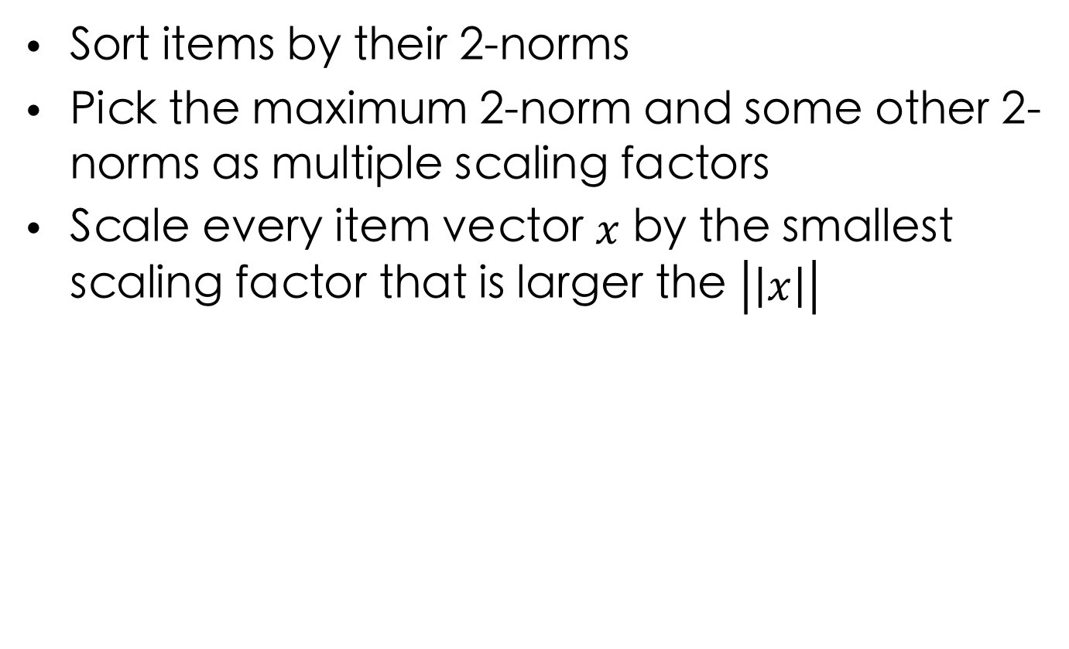
Norm-ranging LSH
Sort items by their 2-norms
Pick the maximum 2-norm and some other 2-norms as multiple scaling factors
Scale every item vector $x$ by the smallest scaling factor that is larger the $\left|\left|x\right|\right|$

Slide 35
Norm-ranging LSH
The distribution of the maximum inner product of 20,000 randomly sampled queries in the ImageNet dataset after the Scaling and Transformation.
Simple LSH
Norm-Ranking LSH

Slide 36
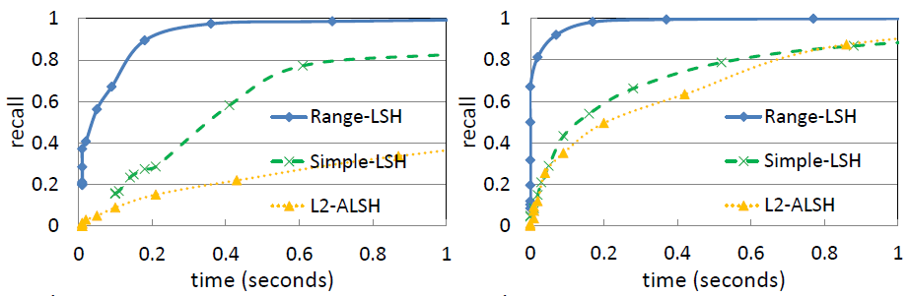
Performance
Time-recall on the Moivelens dataset 16bit code(left), 32bit code(right).
Notes:
Based on the idea of multiple scaling factors, we develop new query algorithm, and outperforms both Simple-LSH and ALSH

Slide 37
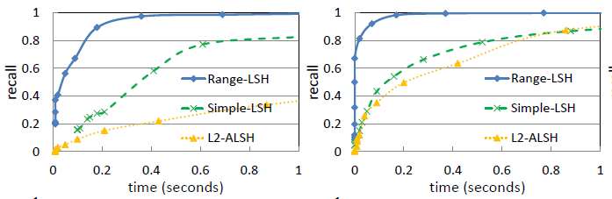
Performance
Time-recall on the Netflix dataset 16bit code(left), 32bit code(right).

Slide 38
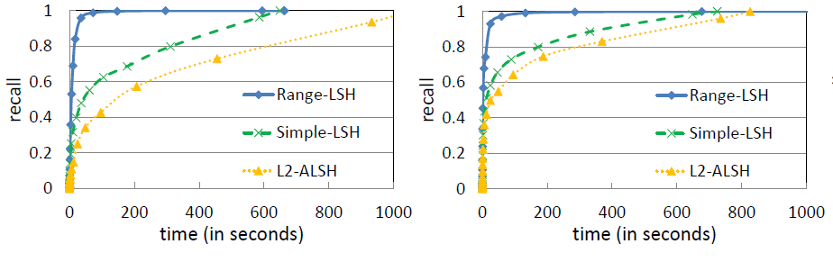
Performance
Time-recall on the Yahoo!Music dataset 16bit (left), 32bit (right).

Slide 39
Outline
LoSHa: A general distributed framework for locality sensitive hashing
Norm-ranging LSH: A Hashing schema for efficient maximum inner product search
GQR querying framework: A general and efficient querying framework for learning to hash algorithms

Slide 40
Learning to Hash for Similarity Search
Learning to hash tailors hash functions for a given dataset
Unsupervised Hashing
Supervised Hashing
Online Hashing
Distributed Hashing
Deep Hashing
…
Notes:
Among all the algorithms for similarity search,

Slide 41
Learning to Hash - Key Operations
Projection
Projects an item to a low-dimensional vector of real numbers
Quantization
Discretizes the projected vector into a binary code by thresholding
Items similar in the original space tend to have similar binary codes (within small hamming distance)
0.3
0.1
O3
O2
-0.1
O1
0
h
Notes:
L2H has two important operations, projection and quantization. The purpose of L2H is that,

Slide 42
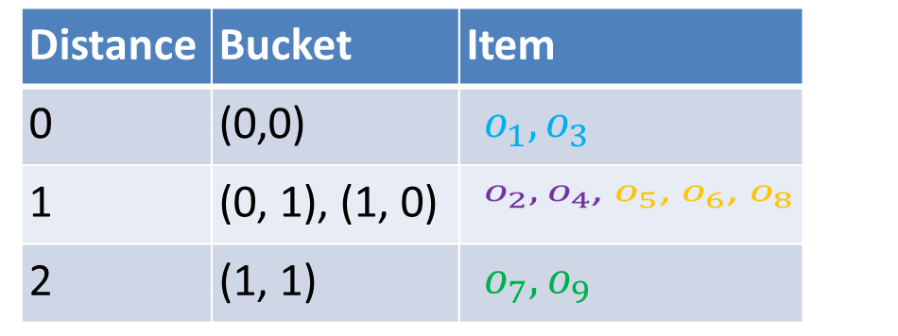
Querying by Hamming Ranking
Hamming ranking: standard query processing method used by learning to hash algorithms
Items with the same binary code are organized into the same bucket
A query probes buckets with smaller hamming distance first
(0, 1)
(1, 1)
(0, 0)
(1, 0)
Notes:
Existing methods adopt hamming ranking as query processing algorithm. Before querying
Hamming ranking is adopted as the default querying algorithm. Before querying, during querying. In this example
Datasets: cannot fit into memory of single machine
of various LSH algorithms
Concurrent queries: require low latency
Different LSH Suit for different application scenas

Slide 43
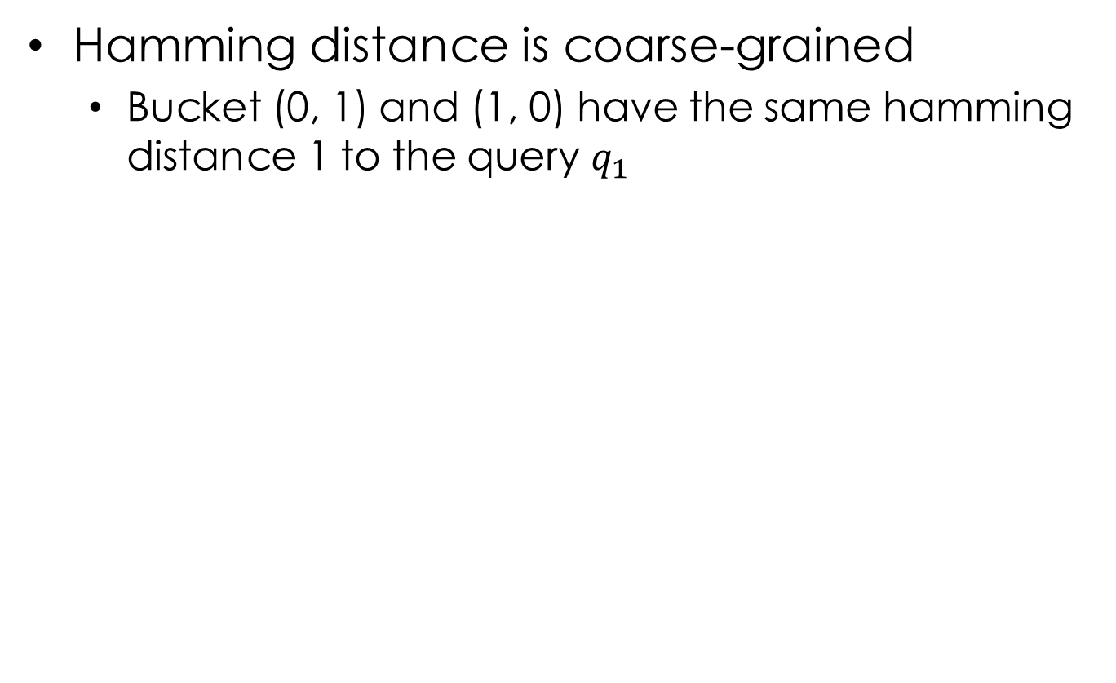
Problem of Hamming Ranking
Hamming distance is coarse-grained
Bucket (0, 1) and (1, 0) have the same hamming distance 1 to the query $q_{1}$
(0, 1)
(1, 1)
(0, 0)
(1, 0)
(code length: 20)
Notes:
In this example, both bucket (0, 1) and (1, 0) have the same hamming distance 1 to query q1. When we use longer codelength, such as 20, we have plenty of buckets that have the same hamming distance to the query.

Slide 44
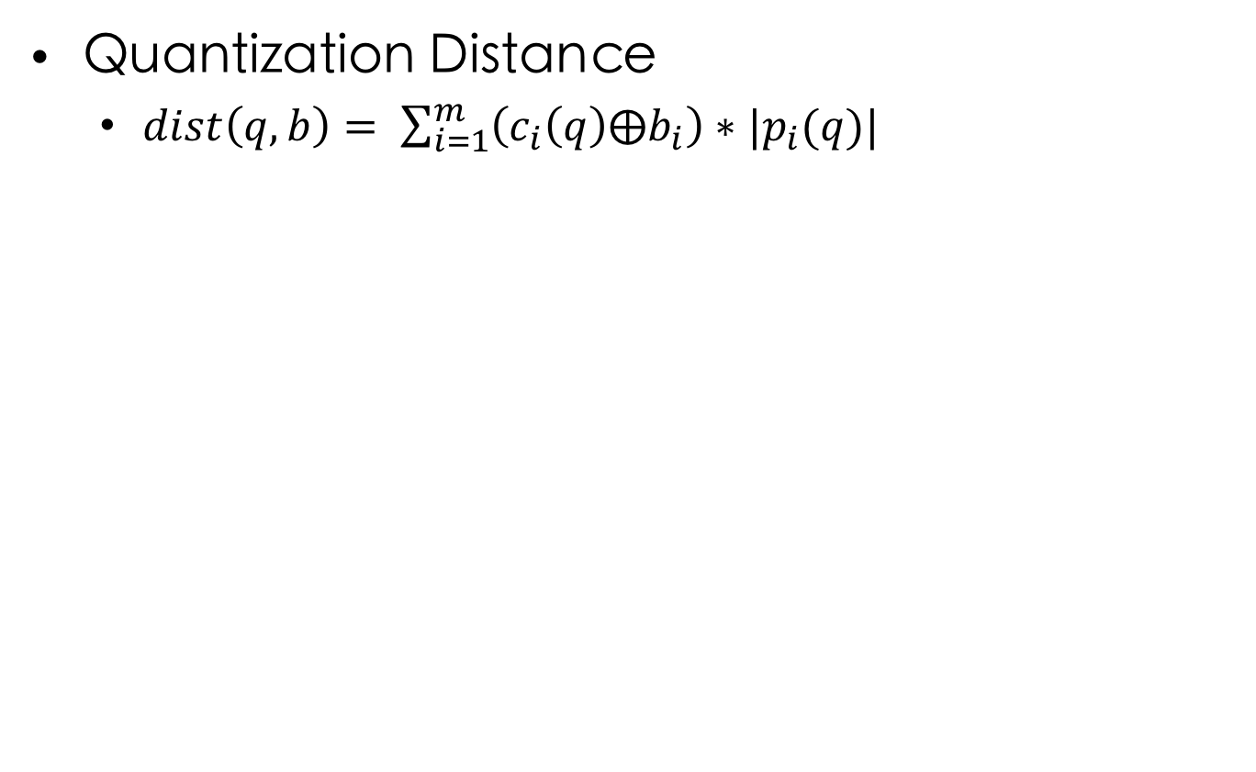
Quantization Distance (QD)
Quantization Distance
$dist\left(q, b\right)= \sum_{i=1}^{m}{\left(c_{i}\left(q\right)⨁b_{i}\right)∗|p_{i}(q)|}$
(0, 1)
(1, 1)
Bucket | HD | QD
(0, 0) | 0 | 0
(1, 0) | 1 | 0.2
(0, 1) | 1 | 0.8
(1, 1) | 2 | 0.2 + 0.8
(0.2, 0.8)
(0, 0)
(1, 0)
Notes:
In this paper, we propose . To solve the coarse-grainularity of hamming distance. We define quantization distance, which takes into account of the absolute projected value, and sums these values of each different bit, and we will be able to distinct buckets of the same hamming distance. The benefit we gain is that we are able to improve the accuracy, in terms of precision

Slide 45
Challenges
Ranking buckets by their quantization distances is expensive (require sorting all the buckets)
Our solution: Generate-to-probe algorithm
Generate buckets in ascending order of their quantization distances to a query
Querying stops after probing a small number of buckets
Notes:
However, there will be no free lunch. Expensive ranking. But luckily, we can generate

Slide 46

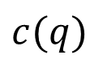

Generate-to-probe Algorithm
Flipping vector
Generate a bucket by flipping the binary bits of the hash code of a query
$$c(q)$$
flipping vector
bucket
0
0
0
1
1
0
$$⊕$$
$$=$$
0
0
0
1
0
1
Notes:
To generate bucket to probe, we define the concept of flipping vector

Slide 47

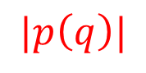
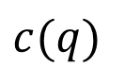
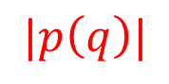
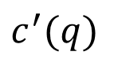
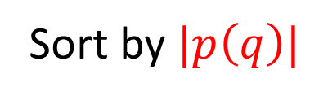
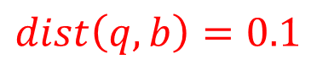
Generate-to-probe Algorithm
Sort the elements inside a projected vector by their absolute values
A flipping vector uniquely maps to a quantization distance, corresponding to the bucket it generates
$$c(q)$$
$$|p\left(q\right)|$$
$$c^{′}(q)$$
$$|p\left(q\right)|$$
$$dist\left(q, b\right)=0.1$$
0
0.2
1
0.1
1
1
0.1
Sort by $|p\left(q\right)|$
0
0.2
0
$$⊕$$
0
0.5
1
0.3
0
1
0.3
0
0.5
0
Notes:
In order to generate buckets in ascending order of their quantization distances. We first sort

Slide 48
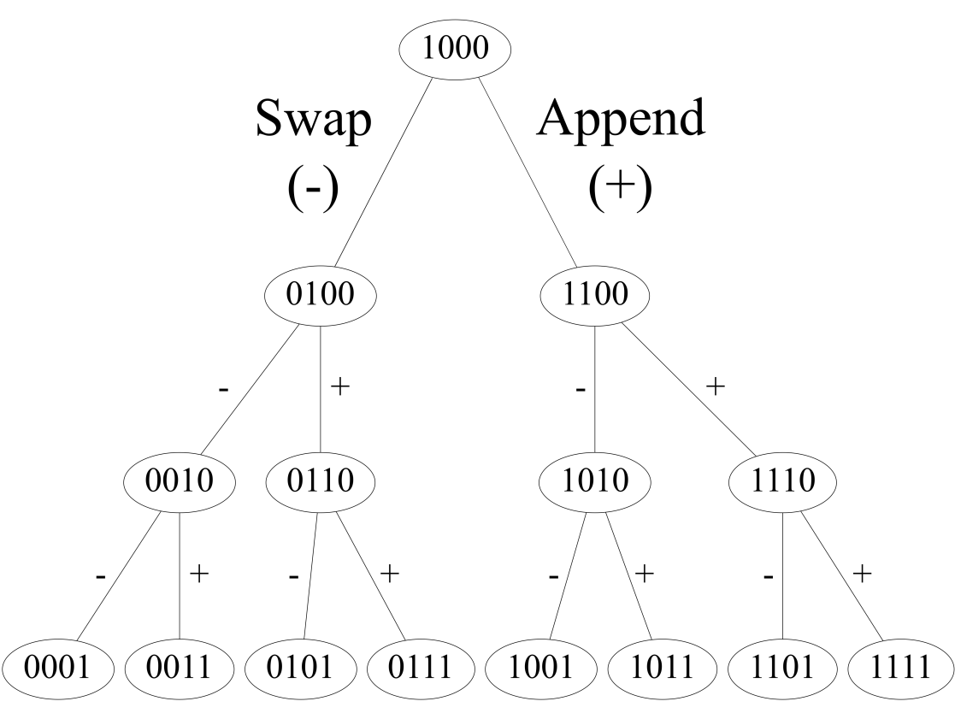
Flipping Vector Tree
A query generates buckets by traversing a flipping vector tree
start with the root flipping vector
continue by Swap and Append
Swap (v-): swap the last 1 and its right zero
Append (v+): append 1 to the last 1
QD(v) < QD(v-)
QD(v) < QD(v+)
Notes:
However, to generate buckets in ascending order of their quantization distance

Slide 49
Experiments – Accuracy
PCAH on Tiny5M dataset (left) and SIFT10M dataset(right)

Slide 50
Experiments – Efficiency
PCAH on Tiny5M (left) and SIFT10M(right)

Slide 51
Experiments – Benefits to Other algorithms
Iterative Quantization Hashing (ITQ) on Tiny5M (left) and SIFT10M(right)
Notes:
More importantly, our method does not just apply to one specific algorithm. Our solution works for a wide range of learning to hash algorithms. In this example, we show the improvement over an important algorithm, ITQ.

Slide 52
Experiments – Benefits to Other algorithms
Spectral Hashing (SH) on Tiny5M (left) and SIFT10M(right)
Notes:
In the next example, we show the improvements of another important algorithm. Note that we choose ITQ and SH because they have more than one thousand citations.

Slide 53
Summary
Quantization Distance
Generate-to-probe algorithm (GQR)
GQR is able to improve the performance of a broad range of learning to hash algorithms
No extra overhead to the learning process

Slide 54
More
GQR is open-source in Github
Support different learning to hash algorithms (e.g. ITQ, PCAH, SH, Sperical Hashing, Kmeans Hashing, Isotropic Hashing,…)
Distributed GQR has been released on LoSHa

Slide 55
Conclusion
We developed LoSHA, a general distributed system for locality sensitive hashing (SIGIR 2017).
Performance: 10x faster than Spark, Similar to PLSH
Resource efficiency: 5x less machines, 10x less network traffic
User-friendliness: 100s/1000s lines of code for LoSHa/Spark respectively
Generality: support many similarity search algorithms, e.g. LSH, L2H, VQ, MIPS …
 | LoSHa | Spark | PLSH (Intel + MIT)
Performance | High | Low | High
Resource efficiency | High | Low | Low
User-friendliness | High | Medium | Low
Generality | High | Medium | Low
Notes:
Four aspects

Slide 56
Conclusion
Scaling is crucial to hashing based maximum inner product search
We first identified the problem that scaling on practical datasets leads to worse query complexity due to lower inner product similarity.
We proposed norm-ranging LSH that adopts multiple scaling factors, and outperforms the state-of-the-art Simple LSH in runtime by an order of magnitude
Notes:
Essential
Scaling degrades the performance on real-word dataset due to smaller inner product

Slide 57
Conclusion
We proposed GQR to improve query processing without the need of a costly and complicated training process (SIGMOD 2018)
Query performance: accelerate querying time of L2H 10x times faster and comparable to VQ (the state-of-the-art unsupervised hashing)
Training performance: remain the lightweight training of L2H (100x faster than VQ)
Generality: orthogonal to the learning process, i.e., can improve a broad range of L2H algorithms such as PCAH,ITQ, Spectral Hashing, K-means Hashing, Isotropic Hashing, …

Slide 58
Other Projects
Husky (SIGMOD Demo 17, PVLDB16, BigData 16)
Distributed machine learning (PVLDB18, PVLDB17)
Graph algorithms (ICDE 16)

Slide 59
Future Work
Natural Language Processing
Data Integration
Notes:
For the next step, I will join megagon labs in the silicon valley.
I will study natural language processing that ..
Data integration that …
My experience on Similarity search and distributed computing can help me develop efficient solutions for problems in this field.

